Slide 1

PATH TO AI
Technology is the sum of techniques, skills, methods, and processes used in the production of goods or services or in the accomplishment of objectives, such as scientific investigation. Technology can be the knowledge of techniques, processes, and the like, or it can be embedded in machines to allow for operation without detailed knowledge of their workings. Systems applying technology by taking an input, changing it according to the system's use, and then producing an outcome are referred to as technology systems or technological systems.
Notes:
QuickStarter has created an outline to help you get started on your presentation. Some slides include information here in the notes to provide additional topics for you to research.

Slide 2

History of AI

Slide 3


History
1950
1960
1970
1980
1990
2000
2010
AI’s failure is
Reported
(Lighthill) [‘73]
Big AI projects are established
(Japan’s ICOT (‘82), US’s MCC (‘83)
And UK’s Alvey (‘84))
Brain science projects
Are established
(BRAIN Initiative and
Human Brain)
The Term AI is
created [‘56]
(Dartmouth
Conference)
A chatterbot ELIZA is
developed [‘64]
AI defeats world
Chess champion [‘97]
AI defeats a former
Shogi title-holder
[‘12]
Turning test is
proposed [‘50]
Zinrai [‘15]
Perceptron is
developed[‘62]
Backpropagation algorithm is developed [‘86]
Lisp is
Developed[‘58]
Deep learning
In spotlight [‘12]
Prolog is
Developed [‘72]
Bayesian network is
Developed [‘88]
The age of search and
deductive reasoning
The age of knowledge
acquisition
The age of
Machine learning
The first AI boom
The second AI boom
The third AI boom
AI programs are able to
solve only trivial “toy”
problems but hardly any
practical ones. Into
“AI winter”
Researchers tried to
teach machines the
knowledge of experts,
which turned out to be
extremely difficult. Into
“AI winter” again
Into the age where
computers acquire
knowledge from data,
not from humans
by machine learning

Slide 4
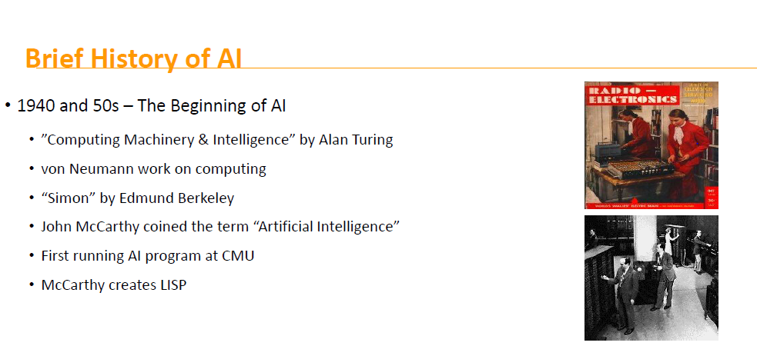

Slide 5
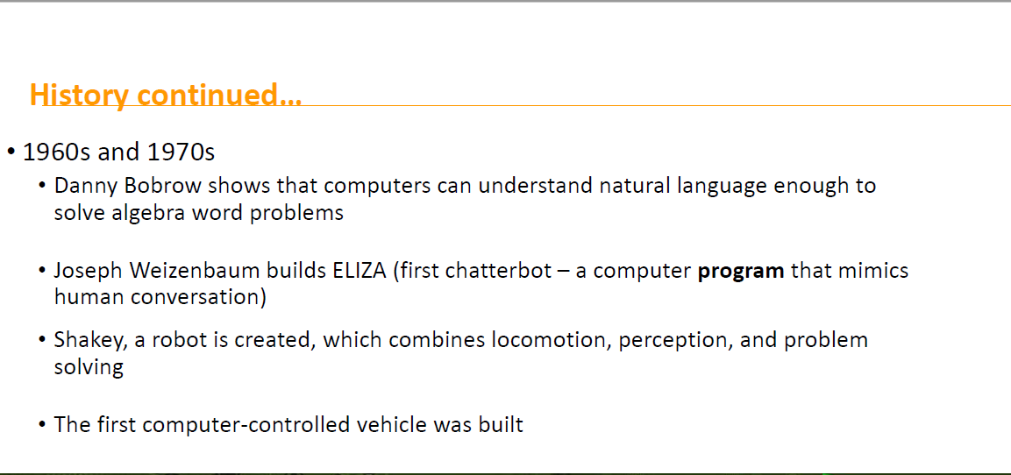

Slide 6
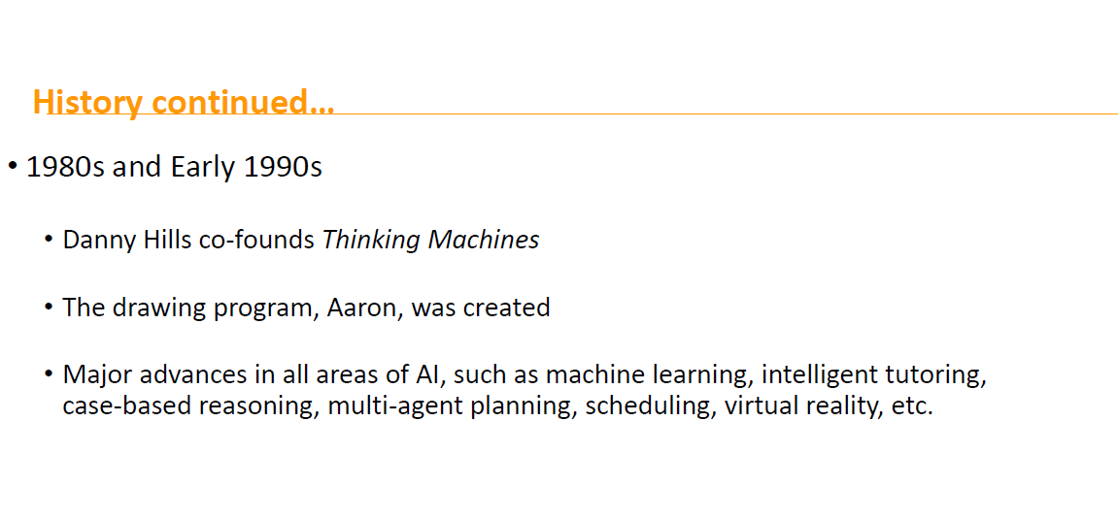

Slide 7
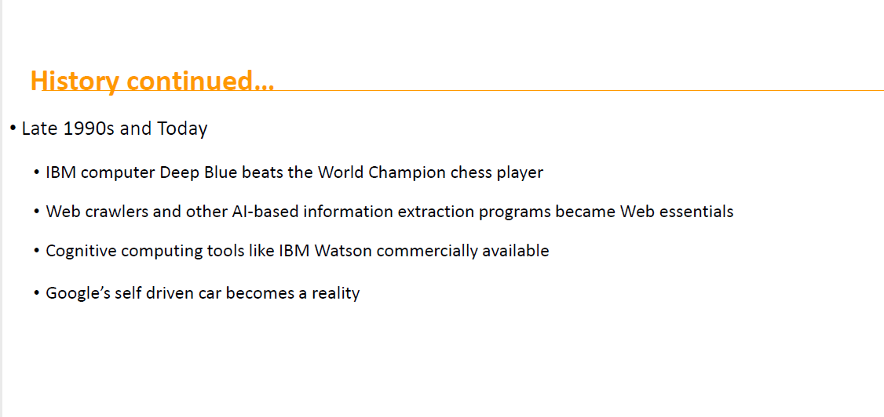

Slide 8
Technology
Notes:
Quotes by Technology:
"I was the principal negotiator for the Department of Defense, when I was secretary of the Navy, on the issue of Toshiba technology concerns with American submarines."
"Television has changed the American child from an irresistable force to an immovable object."
"Everyone has a right to a university degree in America, even if it's in Hamburger Technology."
"The music and movie business has been consistently wrong in its claims that new platforms and channels would be the end of its businesses. In each case, the new technology produced a new market far larger than the impact it had on the existing market."
"The federal government... knows how to put a missile in someone's room half way around the world with technology. Why don't we use some of that technology to save some lives here in America?"
"If your strategy calls for you to be in America, then you will go into America. If your strategy calls for you to be in M&A, then you'll do an acquisition. You usually acquire a company to acquire technology, geographic advantage, etc. Similarly, geographic expansion is very much like M&A. It's done to advance a strategy."
"Making duplicate copies and computer printouts of things no one wanted even one of in the first place is giving America a new sense of purpose."
"I think we should be very worried because, with technology, Boko Haram and other terrorists have become very mobile in all continents, not only in Africa but also in Europe, America, and Asia."
"Once archaeologists have shown possible 'new' ancient features, they can import the data into their iPads and take it to the field to do survey or excavation work. Technology doesn't mean we aren't digging in the dirt anymore - it's just that we know better where to dig."
"In the technology world, you have to execute fast or you're out of business."

Slide 9

Works cited

